Slide 1
Deadlocks Lesson 1 Prevention & Avoidance
David Liu
Fall 2021, Spring 2022

Slide 2
Learning Outcomes
Illustrate how deadlock can occur when mutex locks are used
Define the four necessary conditions that characterize deadlock
Identify a deadlock situation in a resource allocation graph
Evaluate the four different approaches for preventing deadlocks
Apply the banker’s algorithm for deadlock avoidance
Apply the deadlock detection algorithm
Evaluate approaches for recovering from deadlock

Slide 3
FOUR (4) Methods for Handling Deadlocks
Ensure that the system will never enter a deadlock state:
Deadlock prevention
Deadlock avoidance
Allow the system to enter a deadlock state and then recover
Deadlock detection and recovery
Ignore the problem and pretend that deadlocks never occur in the system.
Ignore

Slide 4
Deadlock Prevention
Invalidate one of the four necessary conditions for deadlock:
Mutual Exclusion – not required for sharable resources (e.g., read-only files); must hold for non-sharable resources
Hold and Wait – must guarantee that whenever a process requests a resource, it does not hold any other resources
Require process to request and be allocated all its resources before it begins execution, or allow process to request resources only when the process has none allocated to it.
Low resource utilization; starvation possible
No Preemption –
If a process that is holding some resources requests another resource that cannot be immediately allocated to it, then all resources currently being held are released
Preempted resources are added to the list of resources for which the process is waiting
Process will be restarted only when it can regain its old resources, as well as the new ones that it is requesting
Circular Wait – impose a total ordering of all resource types, and require that each process requests resources in an increasing order of enumeration

Slide 5
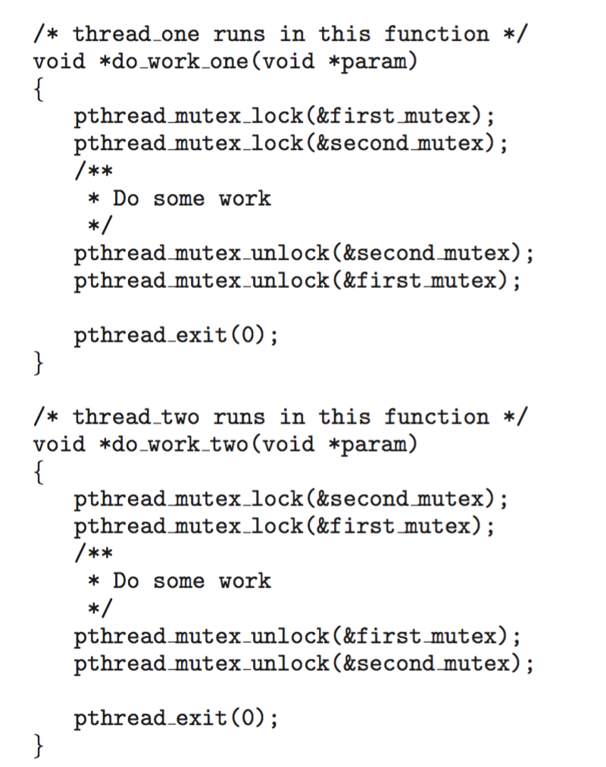
Circular Wait -- Practical
Invalidating the circular wait condition is most common.
Simply assign each resource (i.e. mutex locks) a unique number.
Resources must be acquired in order.
If: first_mutex = 1 second_mutex = 5 code for thread_two could not be written as follows:

Slide 6
Deadlock Avoidance
Requires that the system has some additional a priori information available
Simplest and most useful model requires that each process declare the maximum number of resources of each type that it may need
The deadlock-avoidance algorithm dynamically examines the resource-allocation state to ensure that there can never be a circular-wait condition
Resource-allocation state is defined by
the number of available
allocated resources,
the maximum demands of the processes

Slide 7
Safe State
When a process requests an available resource, system must decide if immediate allocation leaves the system in a safe state
System is in safe state if there exists a sequence <P₁, P₂, …, P_{n}> of ALL the processes in the systems such that for each P_{i}, the resources that P_{i} can still request can be satisfied by currently available resources + resources held by all the P_{j}, with j < i
That is:
If P_{i} resource needs are not immediately available, then P_{i} can wait until all P_{j} with j < i have finished
When P_{j} is finished, P_{i} can obtain needed resources, execute, return allocated resources, and terminate
When P_{i} terminates, P_{i +1} can obtain its needed resources, and so on

Slide 8
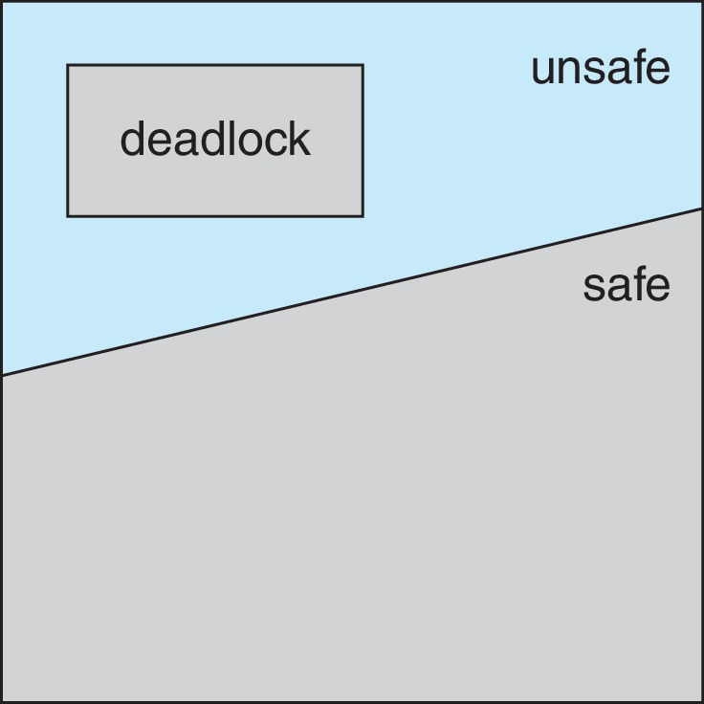
Basic Facts
If a system is in safe state ⇒ no deadlocks
If a system is in unsafe state ⇒ possibility of deadlock
Avoidance ⇒ ensure that a system will never enter an unsafe state.

Slide 9
Avoidance Algorithms
Single instance of a resource type
Use a resource-allocation graph
Multiple instances of a resource type
Use the Banker’s Algorithm

Slide 10
Resource-Allocation Graph Scheme For Single Instance of Each Resource
Claim edge P_{i} → R_{j} indicated that process P_{j} may request resource R_{j}; represented by a dashed line
Claim edge converts to request edge when a process requests a resource
Request edge converted to an assignment edge when the resource is allocated to the process
When a resource is released by a process, assignment edge reconverts to a claim edge
Resources must be claimed a priori in the system

Slide 11
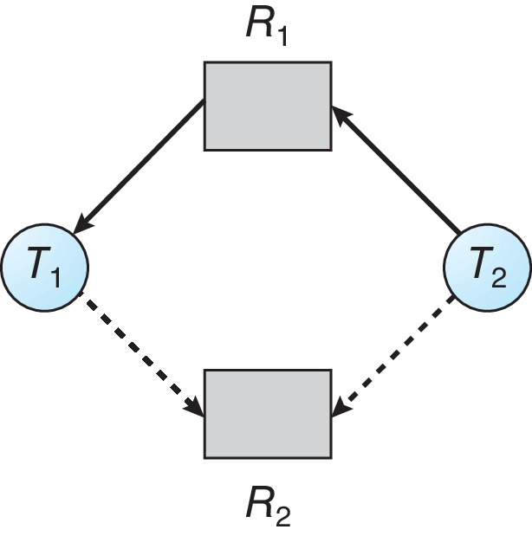
Resource-Allocation Graph
Can we allocate R₂ to T₂?

Slide 12
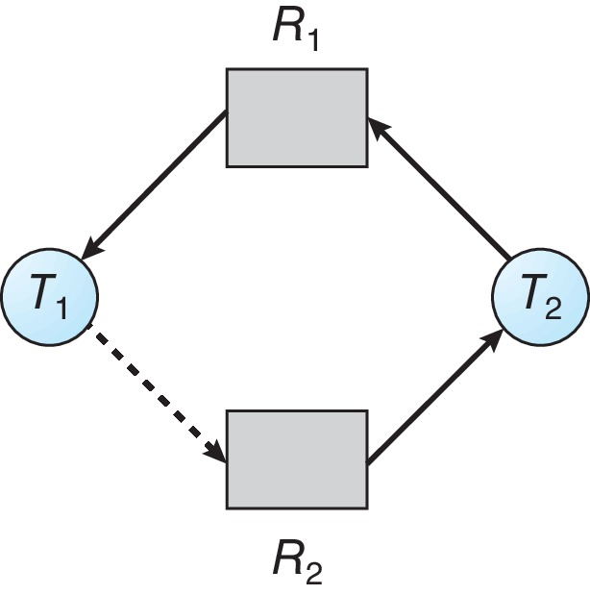
Unsafe State In Resource-Allocation Graph

Slide 13
Resource-Allocation Graph Algorithm
Suppose that process P_{i} requests a resource R_{j}
The request can be granted only if converting the request edge to an assignment edge does not result in the formation of a cycle in the resource allocation graph

Slide 14
Banker’s Algorithm
Multiple instances of resources
Each process must a priori claim maximum use
When a process requests a resource it may have to wait
When a process gets all its resources it must return them in a finite amount of time

Slide 15
Data Structures for the Banker’s Algorithm
Let n = number of processes, and m = number of resources types.
Available: Vector of length m. If available [j] = k, there are k instances of resource type R_{j} available
Max: n x m matrix. If Max [i,j] = k, then process P_{i} may request at most k instances of resource type R_{j}
Allocation: n x m matrix. If Allocation[i,j] = k then P_{i} is currently allocated k instances of R_{j}
Need: n x m matrix. If Need[i,j] = k, then P_{i} may need k more instances of R_{j} to complete its task
Need [i,j] = Max[i,j] – Allocation [i,j]

Slide 16
Safety Algorithm
1. Let Work and Finish be vectors of length m and n, respectively. Initialize:
Work = Available
Finish [i] = false for i = 0, 1, …, n- 1
2. Find an i such that both:
(a) Finish [i] = false
(b) Need_{i} ≤ Work
If no such i exists, go to step 4
3. Work = Work + Allocation_{i} Finish[i] = true go to step 2
4. If Finish [i] == true for all i,
then the system is in a safe state
else
the system is in a unsafe state

Slide 17
Resource-Request Algorithm for Process P_{i}
Request_{i} = request vector for process P_{i}. If Request_{i} [j] = k then process P_{i} wants k instances of resource type R_{j}
1. If Request_{i} ≤ Need_{i} go to step 2. Otherwise, raise error condition, since process has exceeded its maximum claim
2. If Request_{i} ≤ Available, go to step 3. Otherwise P_{i} must wait, since resources are not available
3. Pretend to allocate requested resources to P_{i} by modifying the state as follows:
Available = Available – Request_{i};
Allocation_{i} = Allocation_{i} + Request_{i};
Need_{i} = Need_{i} – Request_{i};
Applying Safety Algorithm
If safe ⇒ the resources are allocated to P_{i}
If unsafe ⇒ P_{i} must wait, and the old resource-allocation state is restored

Slide 18
Example of Banker’s Algorithm
5 processes P₀ through P₄;
3 resource types:
A (10 instances), B (5instances), and C (7 instances)
Snapshot at time T₀:
Allocation Max Available
A B C A B C A B C 3 3 2
P₀ 0 1 0 7 5 3
P₁ 2 0 0 3 2 2
P₂ 3 0 2 9 0 2
P₃ 2 1 1 2 2 2
P₄ 0 0 2 4 3 3

Slide 19
Example (Cont.)
The content of the matrix Need is defined to be Max – Allocation
Need
A B C
P₀ 7 4 3
P₁ 1 2 2
P₂ 6 0 0
P₃ 0 1 1
P₄ 4 3 1
The system is in a safe state since the sequence < P₁, P₃, P₄, P₂, P₀> satisfies safety criteria

Slide 20
Example: P₁ Request (1,0,2)
Check that Request ≤ Available (that is, (1,0,2) ≤ (3,3,2) ⇒ true
Executing safety algorithm shows that sequence < P₁, P₃, P₄, P₀, P₂> satisfies safety requirement
Allocation Need Available
A B C A B C A B C
P₀ 0 1 0 7 4 3 3 3 2
P₁ 2 0 0 1 2 2
P₂ 3 0 2 6 0 0
P₃ 2 1 1 0 1 1
P₄ 0 0 2 4 3 1
Allocation Need Available
A B C A B C A B C
P₀ 0 1 0 7 4 3 2 3 0
P₁ 3 0 2 0 2 0
P₂ 3 0 2 6 0 0
P₃ 2 1 1 0 1 1
P₄ 0 0 2 4 3 1

Slide 21
Safety Algorithm
sequence < P₁, P₃, P₄, P₀, P₂> satisfies safety requirement
Allocation Need Available
A B C A B C A B C
P₀ 0 1 0 7 4 3 2 3 0
P₁ 3 0 2 0 2 0
P₂ 3 0 2 6 0 0
P₃ 2 1 1 0 1 1
P₄ 0 0 2 4 3 1
Safe state??

Slide 22
Safety Algorithm
P₁, P₃, P₄, P₀, P₂
Allocation Need Available
A B C A B C A B C
P₀ 0 1 0 7 4 3 2 3 0
P₁ 3 0 2 0 2 0
P₂ 3 0 2 6 0 0
P₃ 2 1 1 0 1 1
P₄ 0 0 2 4 3 1
Allocation Need Available
A B C A B C A B C
P₀ 0 1 0 7 4 3 5 3 2
P₁ 3 0 2 0 2 0
P₂ 3 0 2 6 0 0
P₃ 2 1 1 0 1 1
P₄ 0 0 2 4 3 1
+
≤
Other possibility besides P₁
Which processes can finish next?

Slide 23
Example: P₄ Request (3,3,0)
Check that Request ≤ Available (that is, (3,3,0) ≤ (3,3,2) ⇒ true
Executing safety algorithm shows that sequence < …..> satisfies safety requirement?
Allocation Need Available
A B C A B C A B C
P₀ 0 1 0 7 4 3 3 3 2
P₁ 2 0 0 1 2 2
P₂ 3 0 2 6 0 0
P₃ 2 1 1 0 1 1
P₄ 0 0 2 4 3 1
Allocation Need Available
A B C A B C A B C
P₀ 0 1 0 7 4 3 0 0 2
P₁ 3 0 2 0 2 0
P₂ 3 0 2 6 0 0
P₃ 2 1 1 0 1 1
P₄ 3 3 2 1 0 1
unsafe

Slide 24
Example: P₀ Request (0,2,0)
Check that Request ≤ Available (that is, (0,2,0) ≤ (3,3,2) ⇒ true
Executing safety algorithm shows that sequence < …..> satisfies safety requirement?
Allocation Need Available
A B C A B C A B C
P₀ 0 1 0 7 4 3 3 3 2
P₁ 2 0 0 1 2 2
P₂ 3 0 2 6 0 0
P₃ 2 1 1 0 1 1
P₄ 0 0 2 4 3 1
Allocation Need Available
A B C A B C A B C
P₀ 0 3 0 7 2 3 3 1 2
P₁ 2 0 0 1 2 2
P₂ 3 0 2 6 0 0
P₃ 2 1 1 0 1 1
P₄ 0 0 2 4 3 1

Slide 25
Example: P₃ Request (0,1,0)
Check that Request ≤ Available (that is, (0,1,0) ≤ (3,3,2) ⇒ true
Executing safety algorithm shows that sequence < …..> satisfies safety requirement?
Allocation Need Available
A B C A B C A B C
P₀ 0 1 0 7 4 3 3 3 2
P₁ 2 0 0 1 2 2
P₂ 3 0 2 6 0 0
P₃ 2 1 1 0 1 1
P₄ 0 0 2 4 3 1
Allocation Need Available
A B C A B C A B C
P₀ 0 1 0 7 4 3 3 2 2
P₁ 2 0 0 1 2 2
P₂ 3 0 2 6 0 0
P₃ 2 2 1 0 0 1
P₄ 0 0 2 4 3 1

